Slide 1
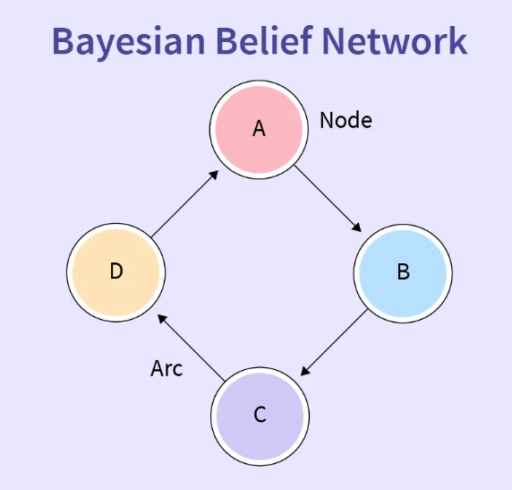
FET -2 (VIDEO PRESENTATION)
NAME : PRATIKSHA P PATIL
ROLL NO.: 19
CLASS : TY CSE B
SUBJECT : INTELLIGENT SYSTEM
GUIDEDE BY:
MRS. : AMBIKA GADAKARI
Bayesian Belief Network (BBN) is a graphical model that represents the probabilistic relationships among variables. It is used to handle uncertainty and make predictions or decisions based on probabilities.
Graphical Representation: Variables are represented as nodes in a directed acyclic graph (DAG), and their dependencies are shown as edges.
Conditional Probabilities: Each node’s probability depends on its parent nodes, expressed as P(Variable | Parent)P(Variable | Parent).
Probabilistic Model: Built from probability distributions, BBNs apply probability theory for tasks like prediction and anomaly detection.
Bayesian Belief Networks are valuable tools for understanding and solving problems involving uncertain events. They are also known as Bayes networks, belief networks, decision networks, or Bayesian models.

Slide 2
Bayesian Belief Network (BBN) is a graphical model that represents the probabilistic relationships among variables. It is used to handle uncertainty and make predictions or decisions based on probabilities.
Graphical Representation: Variables are represented as nodes in a directed acyclic graph (DAG), and their dependencies are shown as edges.
Conditional Probabilities: Each node’s probability depends on its parent nodes, expressed as P(Variable | Parent)P(Variable | Parent).
Probabilistic Model: Built from probability distributions, BBNs apply probability theory for tasks like prediction and anomaly detection.
Bayesian Belief Networks are valuable tools for understanding and solving problems involving uncertain events. They are also known as Bayes networks, belief networks, decision networks, or Bayesian models.
Applications of Bayesian Belief Networks
Medical Diagnosis
Predicting diseases based on symptoms and patient history.
Example: Detecting cancer from genetic data and test results.
Fault Diagnosis in Engineering
Monitoring and identifying faults in complex systems like aircraft or power plants.
Risk Management
Assessing financial risk, insurance modeling, or security threats.
Natural Language Processing
Word-sense disambiguation, part-of-speech tagging using contextual probabilities.
Bioinformatics
Gene expression analysis and protein interaction modeling.
Decision Support Systems
Providing recommendations in uncertain environments, e.g., recommender systems.

Slide 3
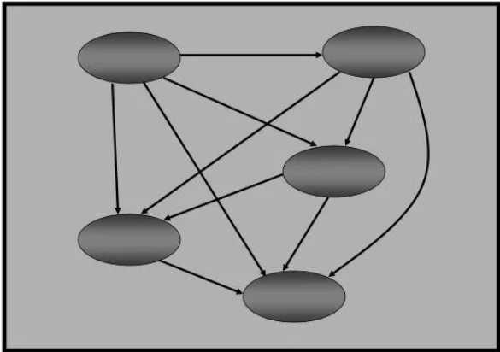
Advantages of Bayesian Belief Networks
Handles Uncertainty
Modular Structure
Causal Modeling
Inference Capabilities
Learning from Data
Applications of Bayesian Belief Networks
Medical Diagnosis
Predicting diseases based on symptoms and patient history.
Example: Detecting cancer from genetic data and test results.
Fault Diagnosis in Engineering
Monitoring and identifying faults in complex systems like aircraft or power plants.
Risk Management
Assessing financial risk, insurance modeling, or security threats.
Natural Language Processing
Word-sense disambiguation, part-of-speech tagging using contextual probabilities.
Bioinformatics
Gene expression analysis and protein interaction modeling.
Decision Support Systems
Providing recommendations in uncertain environments, e.g., recommender systems.

Slide 4
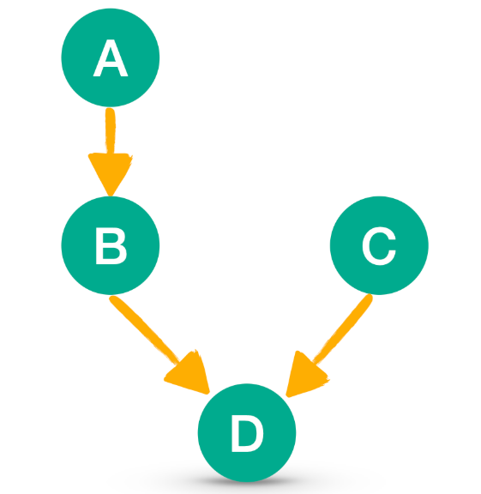
Advantages of Bayesian Belief Networks
Handles Uncertainty
Modular Structure
Causal Modeling
Inference Capabilities
Learning from Data
Disadvantages of Bayesian Belief Networks
Computational Complexity
Requires Expert Knowledge
Data Demands
Not Ideal for Continuous Variables
Static Model

Slide 5
Disadvantages of Bayesian Belief Networks
Computational Complexity
Requires Expert Knowledge
Data Demands
Not Ideal for Continuous Variables
Static Model
Cancer Diagnosis Tool Using Bayesian Belief Network
Structure:
Inputs:
Symptoms: Chest pain, coughing blood, fatigue
Test Results: CT scan, biopsy
Genetic Factors: Mutation presence, family history
Lifestyle Factors: Smoking history
Output:
Probability of cancer types: e.g., Lung Cancer, Breast Cancer, Leukemia
How It Works:
Nodes represent variables (e.g., symptoms, test results).
Edges represent dependencies (e.g., smoking → lung cancer).
Each node has a Conditional Probability Table (CPT) based on parent nodes.
When patient data is input (e.g., heavy smoker, positive biopsy), the network calculates the posterior probability of having a certain type of cancer.

Slide 6
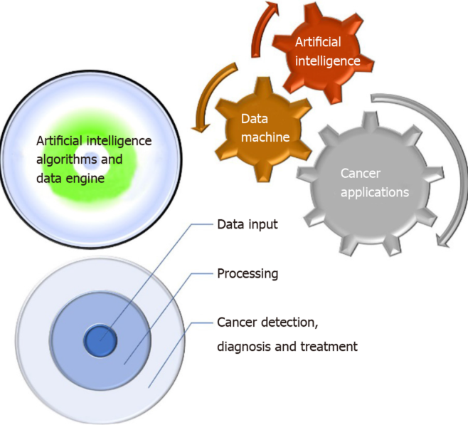
Example:
Patient info:
Heavy smoker
Chest pain
Positive biopsy
Genetic mutation present
Output:
P(Lung Cancer) = 91%
P(Breast Cancer) = 5%
Cancer Diagnosis Tool Using Bayesian Belief Network
Structure:
Inputs:
Symptoms: Chest pain, coughing blood, fatigue
Test Results: CT scan, biopsy
Genetic Factors: Mutation presence, family history
Lifestyle Factors: Smoking history
Output:
Probability of cancer types: e.g., Lung Cancer, Breast Cancer, Leukemia
How It Works:
Nodes represent variables (e.g., symptoms, test results).
Edges represent dependencies (e.g., smoking → lung cancer).
Each node has a Conditional Probability Table (CPT) based on parent nodes.
When patient data is input (e.g., heavy smoker, positive biopsy), the network calculates the posterior probability of having a certain type of cancer.

Slide 7
Example:
Patient info:
Heavy smoker
Chest pain
Positive biopsy
Genetic mutation present
Output:
P(Lung Cancer) = 91%
P(Breast Cancer) = 5%
THANK YOU..

Slide 8
THANK YOU..

